Slide 1
QF604: Econometrics of Financial Markets
Jin, Kim, Quek, Wang and Woon (2019)

Slide 2
The Dow Jones Utility Average & Smart Beta Alternatives
Introduction
Data Sources & Preparation
Smart Beta Index Construction, Methodology & Initial Findings
Index Performance Appraisal
Autocorrelation of Fundamentals
Further Regression Studies
Conclusion

Slide 3
Introduction
1

Slide 4
Introduction
The Dow Jones Utility Average (DJUA), a member of the Dow Jones Global Indexes, was created in 1929 when utility stocks were removed from the Dow Jones Industrial Average.
The DJUA tracks the overall performance of a small group of 15 utility stocks traded in the U.S. by using a price-weighted average method.
Constituent companies are primarily producers of utility resources such as electricity and natural gas.

Slide 5
Introduction
In addition, these utility companies typically pay sizable dividends and provide a steady stream of dividend income relative to companies from other sectors as they face less uncertainty and minimal future volatility due to nature of their industry.
This therefore results in utility sector stocks to be typically seen as a favourite for retirees and other income-seeking investors.
In hope of constructing an index that outperforms the price-weighted DJUA, our team decided to construct smart-beta indices which weigh constituent stocks by fundamentals instead of price. We then analysed and appraised the findings of our endeavour.

Slide 6
Data Sources & Preparation
2

Slide 7
Data Sources & Preparation
Our data sample includes stock and relevant fundamentals data on all stocks which have ever been members of the Dow Jones Utility Average index for the period between 1963 and 2018 (the sample period).
We obtained the bulk of our data from Wharton Research Data Services (WRDS), from which the Center for Research in Security Prices (CRSP), Compustat - Capital IQ and CRSP/Compustat Merged Database (CCM) databases were utilised.
We also tapped on the Bloomberg database for index price data and membership data on the Dow Jones Utility Average, though the information provided was incomplete and was supplemented by information from this article by Global Financial Data.

Slide 8
Center for Research in Security Prices (CRSP)
The Center for Research in Security Prices (CRSP) provided us with relevant data on:
Monthly closing price,
Adjusted returns
Outstanding number of stocks.
PERMCOs and PERMNOs as unique entity and issue-level identifiers when navigating the CRSP database.

Slide 9
Compustat - Capital IQ
Compustat provided us with the relevant fundamentals data (e.g. Net Income, Operating Cash Flow etc) on the relevant constituent stocks of the Dow Jones Utility Average.
We used GVKEY as unique entity-level identifiers when navigating the Compustat database.

Slide 10
CRSP/Compustat Merged Database (CCM)
We used the CCM Database to obtain the links between the unique PERMCO and GVKEY identifiers for the CRSP and Compustat databases respectively.
This allowed us to be able to link stock price and market capitalisation data to other corresponding fundamentals (e.g. computed ROCE, ROA numbers) data at the entity level. With that said, not all required data was found to be available for our sample period.

Slide 11
Computation of Fundamentals
Description | Equation | Price Return Index | Total Return Index | Comments
Market Capitalisation | Share Price x No. of Shares Outstanding | Yes | Yes
Return on Assets | Net Income/Total Assets | Yes | Yes
Return on Capital Employed | EBIT/Capital Employed | Yes | Yes | Capital Employed = Total Assets - Current Liabilities
Return on Invested Capital | NOPAT/Invested Capital | Yes | Yes | NOPAT = EBIT x (1-Tax Rate)
Gross Margin | Gross Profit/Revenue | Yes | Yes
Profit Margin | Net Income/Revenue | Yes | Yes
EBITDA Margin | EBITDA/Revenue | Yes | Yes
Operating Cash Flow Margin | Operating Cash Flow/Revenue |  | Yes
Current Ratio | Current Assets/Current Liabilities | Yes | Yes
Long Term Debt to Total Equity | Long Term Debt/Total Equity | Yes | Yes

Slide 12
Some Data Constraints
We only started our smart beta Total Return indices from June 1988 owing to a lack of prior price data on the relevant benchmark index (the Dow Jones Utility Average Total Return) and on Operating Cash Flow Margin fundamentals data.
As can be inferred, owing to a lack of data, price return smart beta indices based on Operating Cash Flow Margin were not constructed.

Slide 13
Smart Beta Index Construction, Methodology & Initial Findings
3

Slide 14
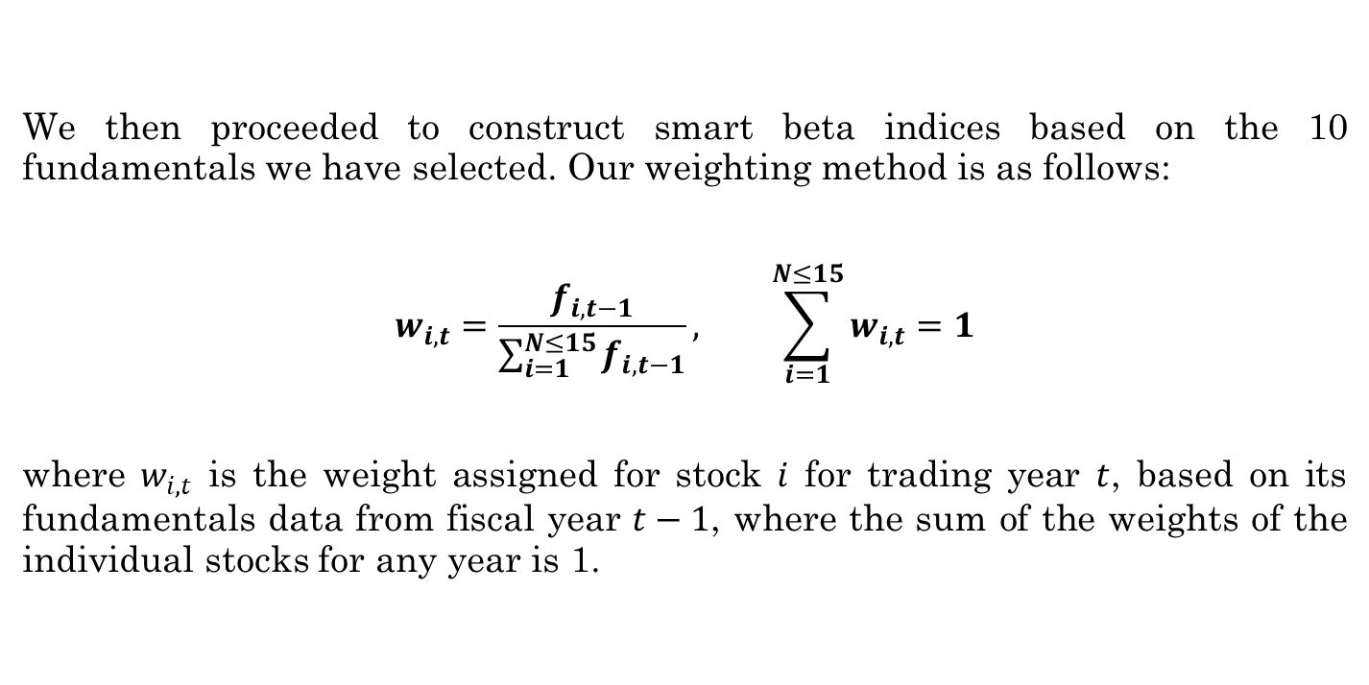
Weighting Method
We then proceeded to construct smart beta indices based on the 10 fundamentals we have selected. Our weighting method is as follows:
$$w_{i,t}=\frac{f_{i,t−1}}{\sum_{i=1}^{N≤15}{f_{i,t−1}}}, \sum_{i=1}^{N≤15}{w_{i,t}}=1$$
where $w_{i,t}$ is the weight assigned for stock $i$ for trading year $t$, based on its fundamentals data from fiscal year $t−1$, where the sum of the weights of the individual stocks for any year is 1.

Slide 15
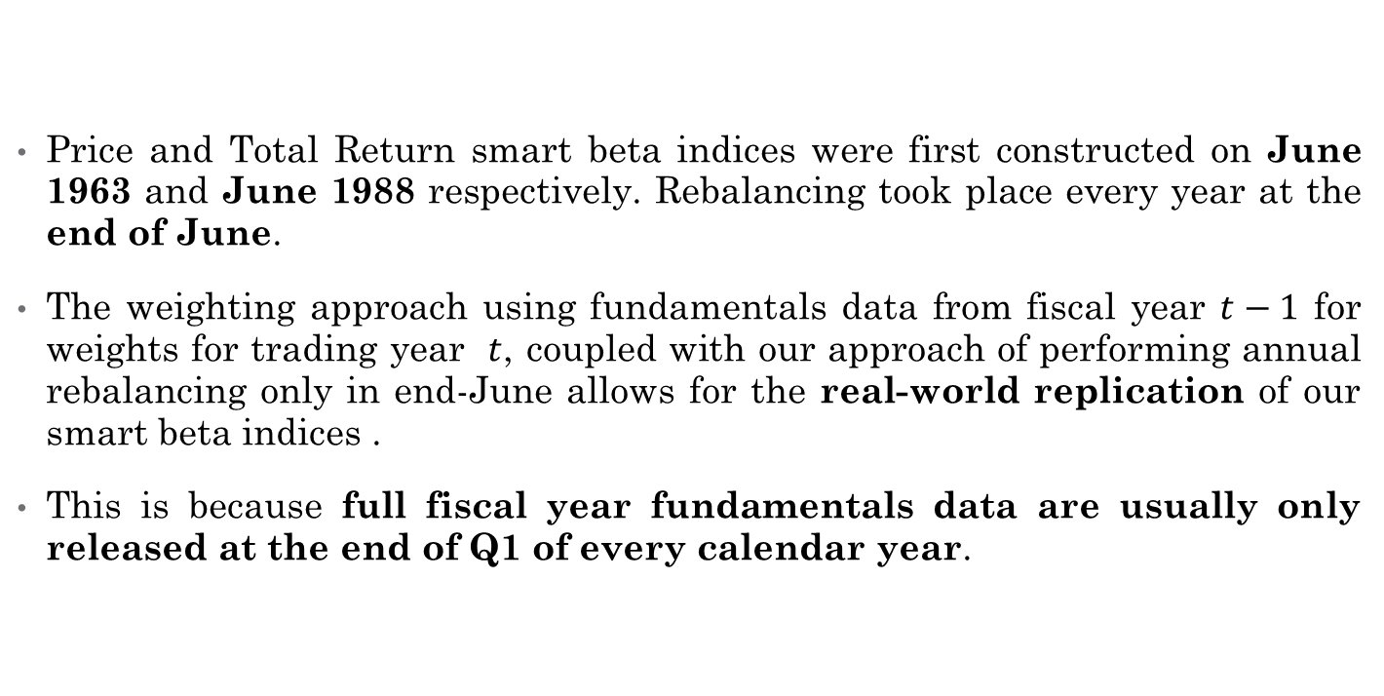
Real-World Replicability
Price and Total Return smart beta indices were first constructed on June 1963 and June 1988 respectively. Rebalancing took place every year at the end of June.
The weighting approach using fundamentals data from fiscal year $t−1$ for weights for trading year $t$, coupled with our approach of performing annual rebalancing only in end-June allows for the real-world replication of our smart beta indices .
This is because full fiscal year fundamentals data are usually only released at the end of Q1 of every calendar year.

Slide 16
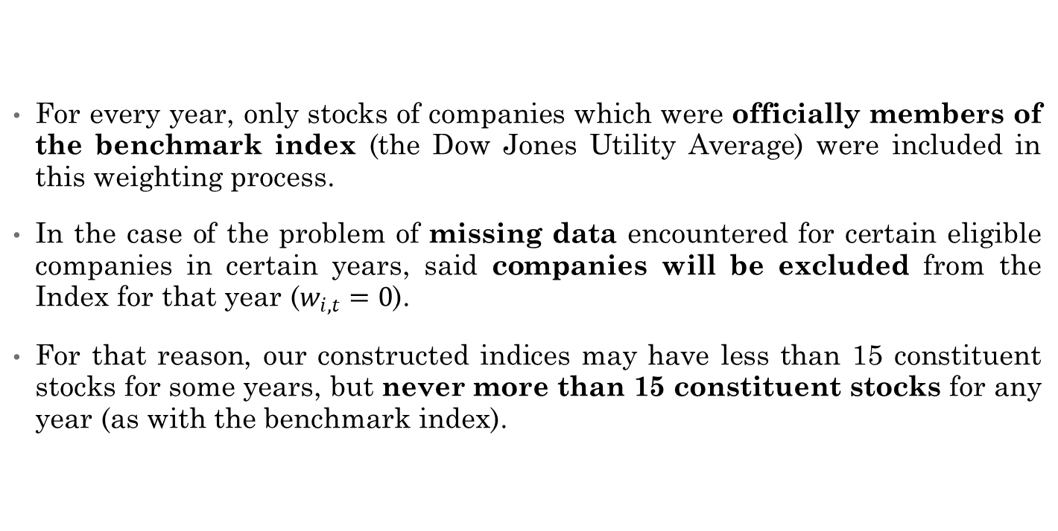
Just Some Rules..
For every year, only stocks of companies which were officially members of the benchmark index (the Dow Jones Utility Average) were included in this weighting process.
In the case of the problem of missing data encountered for certain eligible companies in certain years, said companies will be excluded from the Index for that year ($w_{i,t}=0$).
For that reason, our constructed indices may have less than 15 constituent stocks for some years, but never more than 15 constituent stocks for any year (as with the benchmark index).

Slide 17
Just Some More Rules..
Given how some of our chosen fundamentals (e.g. ROA, ROCE, ROIC etc) can take on negative values, we allowed our indices to be fully unconstrained.
This means that long or short positions on eligible stocks were permitted with no set limits.
We also established an “absorbing state” for the prices of the smart beta indices to be at 0 (indicating a total loss of initial capital), with any of our indices reaching or exceeding that floor deemed to be failed ones and as such excluded from further analysis.

Slide 18
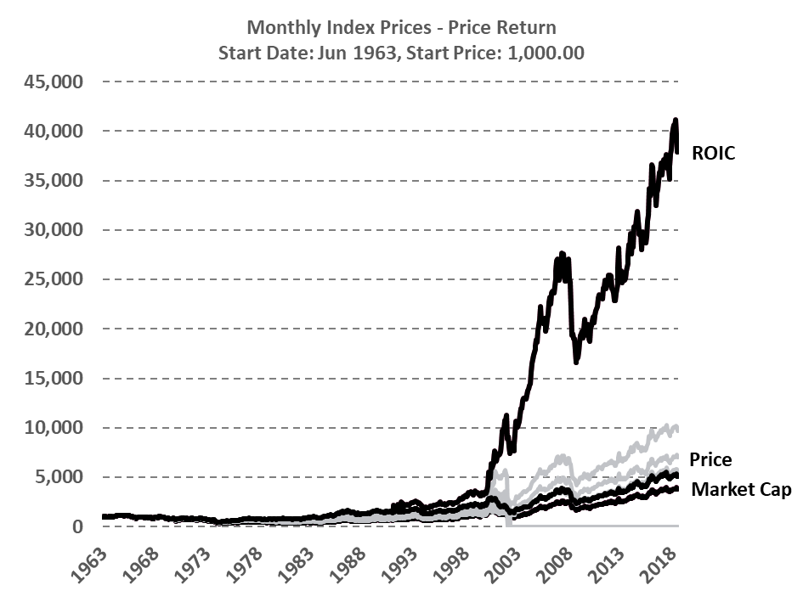
Initial Findings
The superior smart beta index become clear as day after the computed smart beta index prices were plotted over time.
For both price return and total return smart beta portfolios, the portfolios with ROIC-based weightings achieved far superior returns over our other constructed indices.

Slide 19
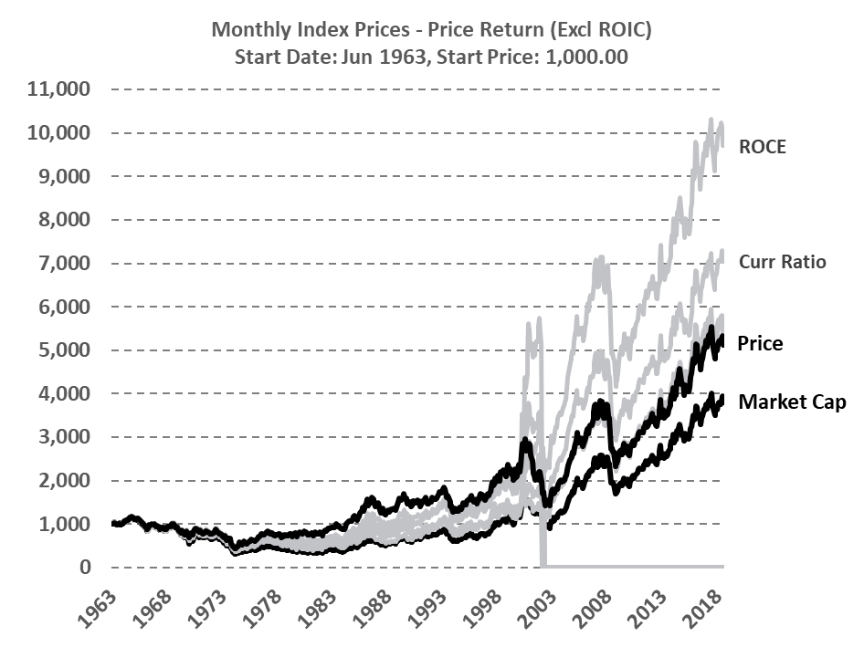
Initial Findings
Coming in as faraway second and third place were the ROCE and Current Ratio-based smart beta indices.
Amongst the portfolios which survived the sample period, indices weighed based on price and market capitalisation performed the worst.

Slide 20
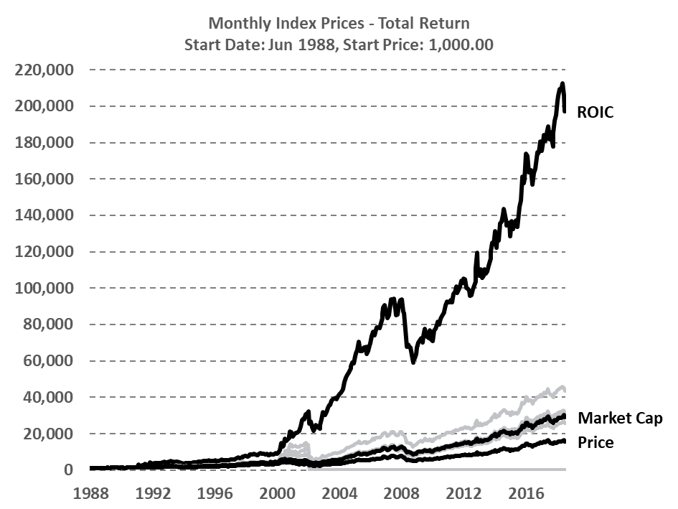
Initial Findings
To put things into perspective:
The value of $1 invested in our constructed ROIC-based total return smart beta portfolio at Jun 1988 would be worth $197.10 at the end of 2018 (excluding transaction costs).
An identical $1 invested in the benchmark total return index over the same time period would be worth “only” $15.77.

Slide 21
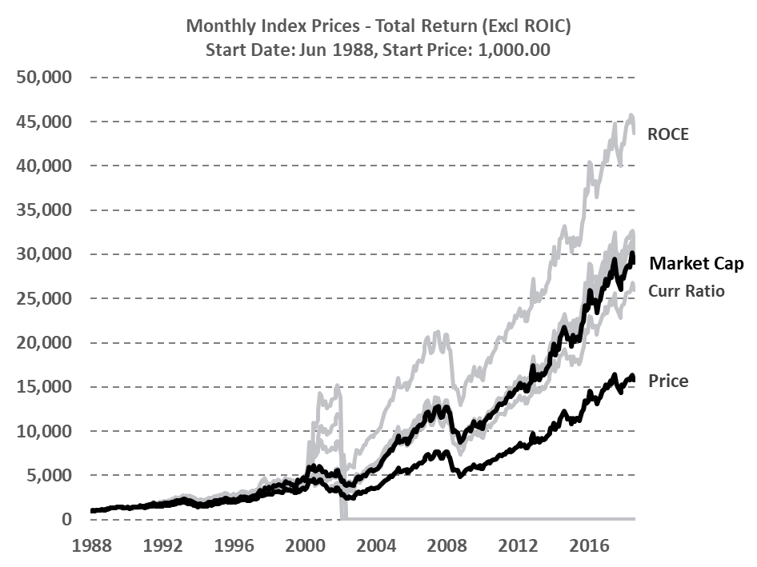
Initial Findings
As with the case of the price return smart beta indices, the second-best performing total return smart beta portfolio was the one weighted based on ROCE.
The Operating Cash Flow Margin-based index came in third.
The price-weighted index was once again amongst the worst performing but surviving ones.

Slide 22
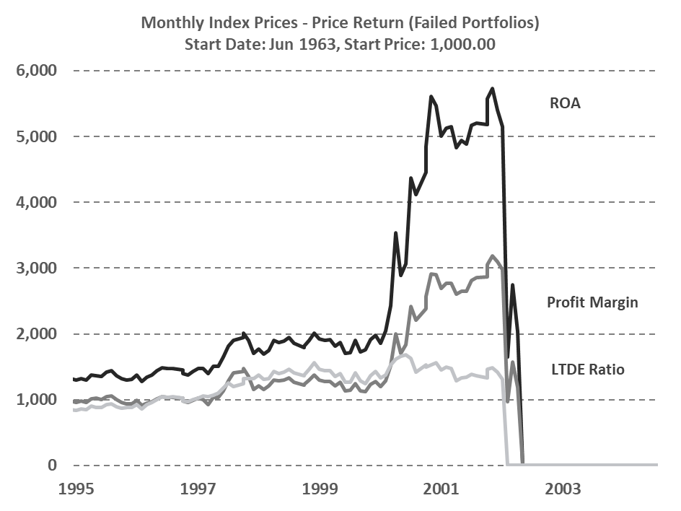
Initial Findings
We also observed a few constructed portfolios which have failed over our sample period (ROA, Profit Margin and LTDE Ratio).
All of the failure cases were the result of a few extensive losses incurred from prescribed unprofitable and extremely large short positions taken on the same few constituent stocks
This is the result of one of the drawbacks that come with allowing fully unconstrained portfolios.
The failures were also observed to all have occurred in mid-to-late 2002.

Slide 23
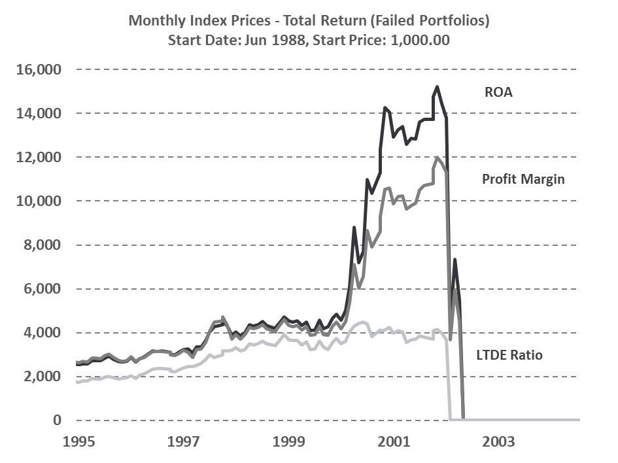
Initial Findings
We also observed a few constructed portfolios which have failed over our sample period (ROA, Profit Margin and LTDE Ratio).
All of the failure cases were the result of a few extensive losses incurred from prescribed unprofitable and extremely large short positions taken on the same few constituent stocks
This is the result of one of the drawbacks that come with allowing fully unconstrained portfolios.
The failures were also observed to all have occurred in mid-to-late 2002.

Slide 24
Index Performance Appraisal
4

Slide 25
Geometric Monthly Price Return
Monthly Performances of Fundamentally Weighted Price Return Indices,
Jan 1964 - Dec 2018
Index | Ending Value of 1$ | Geometric Return | Volatility | VS RF rate (3M US Treasury) |  |  | VS Original Index
 |  |  |  | Excess Return | Sharpe Ratio | t-Stats* | Excess Return | Information Ratio | t-Stats*
DJUAPR | $ 5.14 | 0.25% | 4.14% | -0.14% | -3.31% | -0.31 | - | - | -
ROIC (Return on Invested Capital) | $ 37.61 | 0.55% | 7.73% | 0.16% | 2.12% | 1.32 | 0.31% | 4.80% | 1.80
ROCE (Return on Capital Employed) | $ 9.67 | 0.34% | 4.79% | -0.04% | -0.87% | 0.39 | 0.10% | 4.71% | 1.48
Gross Margin | $ 5.52 | 0.26% | 4.53% | -0.13% | -2.79% | -0.13 | 0.01% | 0.66% | 0.40
EBITDA Margin | $ 5.34 | 0.25% | 4.51% | -0.13% | -2.92% | -0.16 | 0.01% | 0.34% | 0.32
Current Ratio | $ 6.99 | 0.30% | 4.49% | -0.09% | -2.02% | 0.07 | 0.05% | 2.65% | 0.90
Market Capitalisation | $ 3.77 | 0.20% | 4.53% | -0.18% | -4.07% | -0.46 | -0.05% | -2.56% | -0.41
Average | $ 10.58 | 0.31% | 4.96% | -0.08% | -1.98% | 0.10 | 0.07% | 1.77% | 0.75

Slide 26
Geometric Monthly Total Return
Monthly Performances of Fundamentally Weighted Total Return Indices,
Jan 1989 - Dec 2018
Index | Ending Value of 1$ | Geometric Return | Volatility | VS RF rate (3M US Treasury) |  |  | VS Original Index
 |  |  |  | Excess Return | Sharpe Ratio | t-Stats* | Excess Return | Information Ratio | t-Stats*
DJUATR | $ 6.16 | 0.75% | 4.17% | 0.51% | 12.14% | 2.70 | - | - | -
ROIC (Return on Invested Capital) | $ 181.77 | 1.46% | 9.32% | 1.21% | 13.03% | 3.11 | 1.07% | 12.78% | 2.17
ROCE (Return on Capital Employed) | $ 40.60 | 1.03% | 4.78% | 0.79% | 16.60% | 3.58 | 0.65% | 26.65% | 3.20
Gross Margin | $ 28.79 | 0.94% | 4.45% | 0.69% | 15.60% | 3.38 | 0.55% | 27.29% | 3.11
EBITDA Margin | $ 28.19 | 0.93% | 4.42% | 0.69% | 15.60% | 3.38 | 0.54% | 27.36% | 3.10
Operating Cash Flow Margin | $ 29.46 | 0.94% | 4.21% | 0.70% | 16.66% | 3.55 | 0.55% | 29.43% | 3.38
Current Ratio | $ 24.56 | 0.89% | 4.44% | 0.65% | 14.65% | 3.20 | 0.51% | 25.58% | 2.34
Market Capitalisation | $ 26.76 | 0.92% | 4.19% | 0.67% | 16.10% | 3.44 | 0.52% | 29.41% | 3.23

Slide 27
Geometric Monthly Price Return
Distribution of Fundamentally Weighted Price Return Indices,
Jan 1964 - Dec 2018
Index | Skewness | Kurtosis | Maximum Monthly Return | Minimum Monthly Return | Maximum 3-Month Return | Minimum 3-Month Return | Maximum 12-Month Return | Minimum 12-Month Return
DJUAPR | -0.23 | 0.82 | 13.41% | -16.02% | 27.68% | -24.55% | 46.70% | -41.68%
ROIC | 8.30 | 138.22 | 134.33% | -30.60% | 125.15% | -27.62% | 161.42% | -43.59%
ROCE | 0.26 | 2.48 | 27.47% | -17.66% | 55.88% | -28.14% | 100.79% | -41.76%
Gross Margin | -0.20 | 1.35 | 16.88% | -21.34% | 40.09% | -30.76% | 62.44% | -44.46%
EBITDA Margin | -0.18 | 1.19 | 16.88% | -20.12% | 37.60% | -28.96% | 56.73% | -44.46%
Current Ratio | -0.21 | 1.67 | 19.25% | -21.33% | 39.49% | -34.02% | 67.16% | -44.29%
Market Capitalisation | -0.02 | 1.22 | 19.44% | -17.65% | 34.76% | -30.31% | 58.32% | -49.46%
Average | 1.11 | 20.99 | 35.38% | -20.68% | 51.52% | -29.19% | 79.08% | -44.24%

Slide 28
Geometric Monthly Total Return
4 Distribution of Fundamentally Weighted Total Return Indices,
Jan 1989- Dec 2018
Index | Skewness | Kurtosis | Maximum Monthly Return | Minimum Monthly Return | Maximum 3-Month Return | Minimum 3-Month Return | Maximum 12-Month Return | Minimum 12-Month Return
DJUATR | -0.48 | 0.55 | 12.39% | -13.33% | 30.78% | -21.63% | 51.65% | -31.80%
ROIC | 8.43 | 117.26 | 134.84% | -28.59% | -26.87% | -26.87% | 194.69% | -32.58%
ROCE | 0.29 | 3.80 | 27.36% | -17.55% | 57.59% | -27.47% | 108.80% | -33.09%
Gross Margin | -0.57 | 1.98 | 15.83% | -21.26% | 40.81% | -30.14% | 67.14% | -33.25%
EBITDA Margin | -0.53 | 1.63 | 14.40% | -20.04% | 38.39% | -28.33% | 61.74% | -31.42%
Operating Cash Flow Margin | -0.43 | 0.68 | 13.93% | -13.00% | 33.52% | -22.70% | 52.94% | -32.84%
Current Ratio | -0.58 | 2.15 | 15.34% | -21.28% | 40.26% | -33.44% | 71.58% | -37.54%
Market Capitalisation | -0.14 | 1.14 | 19.37% | -11.18% | 35.80% | -22.07% | 63.38% | -27.70%
Average | 0.75 | 16.15 | 31.68% | -18.28% | 31.28% | -26.58% | 83.99% | -32.53%

Slide 29
Arithmetic Annual Price Return
 | Price Return (Arithmetic)
Jan 1964- Dec 2018 | DJU | Market Cap | ROIC | ROC | Gross Margin | EBITDA Margin | Curr Ratio
Annual return
Average Annual Return (%) | 4.34% | 3.91% | 9.47% | 5.89% | 4.68% | 4.55% | 5.20%
Annual Volatility (%) | 16.31% | 17.38% | 27.20% | 19.49% | 17.71% | 17.27% | 18.17%
Average Annual Risk Free Rate (%) | 4.78% | 4.78% | 4.78% | 4.78% | 4.78% | 4.78% | 4.78%
End Value with 1$ invested | 5.13 | 3.77 | 37.61 | 9.67 | 5.52 | 5.34 | 6.99
Ratios (net of Rf)
Sharpe Ratio (%) | -2.65% | -4.84% | 17.05% | 5.56% | -0.56% | -1.29% | 2.23%
Downside Volatility (%) | 11.39% | 10.75% | 11.87% | 11.08% | 11.05% | 10.87% | 11.59%
Sortino Ratio (%) | -3.89% | -8.09% | 39.51% | 10.05% | -0.93% | -2.12% | 3.59%
Extreme Risk Statistics
Best Monthly Return (%) | 45.45% | 19.44% | 134.33% | 27.47% | 16.88% | 16.88% | 19.25%
Worst Monthly Return (%) | -30.38% | -17.65% | -30.60% | -17.66% | -21.34% | -20.12% | -21.33%
Percentage of Months with + Return (not netting of Rf) | 55.30% | 55.12% | 56.73% | 56.14% | 55.12% | 55.85% | 54.82%
Performance Relative to the DJU (net of Rf)
Annually Alpha | 0 | -0.0041 | 0.0516 | 0.0160 | 0.0036 | 0.0022 | 0.0089
Annually Beta to Market | 1 | 1.03 | 1.07 | 1.10 | 1.03 | 1.02 | 1.06
Annually Correlation with DJU | 1 | 0.95 | 0.64 | 0.91 | 0.94 | 0.94 | 0.95

Slide 30
Arithmetic Annual Total Return
 | Total Return (Arithmetic)
Jan 1989-Dec 2018 | DJU | Market Cap | ROIC | ROC | Gross Margin | EBITDA Margin | Op CF Margin | Curr Ratio
Annual return
Average Annual Return (%) | 11.02% | 13.13% | 22.82% | 15.24% | 13.61% | 13.42% | 13.39% | 13.13%
Annual Volatility (%) | 18.70% | 18.82% | 36.03% | 22.84% | 19.73% | 19.06% | 17.85% | 20.29%
Average Annual Risk Free Rate (%) | 3.04% | 3.04% | 3.04% | 3.04% | 3.04% | 3.04% | 3.04% | 3.04%
End Value with 1$ invested | 14.71 | 26.76 | 181.77 | 40.60 | 28.79 | 28.19 | 29.46 | 24.56
Ratios (net of Rf)
Sharpe Ratio (%) | 42.58% | 54.2% | 56.1% | 54.2% | 53.7% | 54.7% | 58.2% | 49.7%
Downside Volatility (%) | 13.95% | 11.75% | 13.76% | 13.57% | 13.39% | 12.94% | 12.32% | 14.77%
Sortino Ratio (%) | 57.21% | 85.90% | 143.76% | 89.97% | 78.97% | 80.21% | 84.04% | 68.36%
Extreme Risk Statistics
Best Month,y Return (%) | 50.76% | 19.37% | 134.84% | 27.36% | 15.83% | 14.40% | 13.93% | 15.34%
Worst Monttly Return (%) | -27.84% | -11.18% | -28.59% | -17.55% | -21.26% | -20.04% | -13.00% | -21.28%
Percentage of Months with + Return (not netting of Rf) | 63.61% | 65.28% | 65.56% | 63.89% | 64.17% | 64.44% | 65.83% | 64.17%
Performance Relative to the DJU (net of Rf)
Annually Alpha | 0 | 0.0233 | 0.1219 | 0.0364 | 0.0272 | 0.0274 | 0.0315 | 0.0200
Annually Beta to Market | 1 | 0.97 | 0.95 | 1.07 | 0.98 | 0.96 | 0.90 | 1.01
Annually Correlation with DJU | 1 | 0.98 | 0.54 | 0.90 | 0.94 | 0.95 | 0.95 | 0.94

Slide 31
Autocorrelation of Fundamentals
5

Slide 32
Autocorrelation of Fundamentals
 | ROA | ROIC | ROCE | Gross Margin | Profit Margin | EBITDA Margin | Op CF Margin* | Curr Ratio | LTDE Ratio | Market Cap
AMERICAN ELECTRIC POWER CO | 0.66 | 0.00 | 0.87 | 0.88 | 0.86 | 0.88 | 0.75 | 0.79 | 0.82 | 0.97
NORAM ENERGY CORP | 0.74 |  |  | 0.81 | 0.81 | 0.81 | -0.50 | 0.75 | 0.79 | 0.85
CENTERIOR ENERGY CORP | -0.08 |  |  | -0.27 | -0.04 | -0.27 | 0.77 | -0.07 | 0.51 | 0.57
COLUMBIA ENERGY GROUP | 0.22 | 0.03 | 0.26 | 0.35 | 0.20 | 0.35 | 0.01 | 0.60 | 0.74 | 0.92
UNICOM CORP | 0.57 | 0.42 | 0.58 | 0.79 | 0.59 | 0.79 | -0.25 | 0.69 | 0.73 | 0.86
CONSOLIDATED EDISON INC | 0.92 | 0.90 | 0.92 | 0.90 | 0.76 | 0.90 | 0.69 | 0.73 | 0.94 | 0.97
CONSOLIDATED NATURAL GAS CO | 0.40 | 0.58 | 0.47 | 0.49 | 0.42 | 0.49 | -0.37 | 0.71 | 0.91 | 0.97
DTE ENERGY CO | 0.11 | 0.75 | 0.67 | 0.79 | 0.13 | 0.79 | 0.65 | 0.42 | 0.62 | 0.98
DOMINION ENERGY INC | 0.33 | 0.46 | 0.72 | 0.76 | 0.44 | 0.76 | 0.44 | 0.64 | 0.84 | 0.97
DUKE ENERGY CORP | 0.77 | 0.79 | 0.80 | 0.84 | 0.74 | 0.84 | 0.59 | 0.62 | 0.85 | 0.95
NEXTERA ENERGY INC | 0.43 | 0.11 | 0.77 | 0.85 | 0.82 | 0.85 | 0.74 | 0.56 | 0.85 | 0.99
CENTERPOINT ENERGY INC | 0.16 | 0.05 | 0.92 | 0.94 | 0.36 | 0.94 | 0.71 | 0.72 | 0.84 | 0.90
ENRON CORP | 0.69 | 0.31 | 0.87 | 0.97 | 0.85 | 0.97 | 0.02 | 0.55 | 0.81 | 0.48
NIAGARA MOHAWK HOLDINGS INC | 0.23 |  |  | 0.22 | 0.24 | 0.22 | -0.08 | 0.53 | 0.72 | 0.89
NISOURCE INC | 0.83 | 0.66 | 0.88 | 0.88 | 0.85 | 0.88 | 0.34 | 0.76 | 0.76 | 0.91
FIRSTENERGY CORP | 0.54 | 0.14 | 0.70 | 0.90 | 0.61 | 0.90 | 0.65 | 0.68 | 0.64 | 0.95
PG&E CORP | 0.24 | 0.13 | 0.23 | 0.80 | 0.25 | 0.80 | 0.40 | 0.09 | 0.71 | 0.92
PANENERGY CORP | 0.18 | 0.58 | 0.49 | 0.82 | 0.34 | 0.82 | -0.52 | 0.60 | 0.85 | 0.90
PEOPLES ENERGY CORP | 0.65 | 0.59 | 0.82 | 0.96 | 0.93 | 0.96 | -0.05 | 0.90 | 0.82 | 0.79
EXELON CORP | 0.08 | 0.70 | 0.67 | 0.83 | 0.20 | 0.83 | 0.26 | 0.54 | 0.42 | 0.95
PUBLIC SERVICE ENTRP GRP INC | 0.31 | 0.15 | 0.77 | 0.87 | 0.42 | 0.87 | 0.78 | 0.71 | 0.91 | 0.95
EDISON INTERNATIONAL | 0.57 | 0.23 | 0.13 | 0.32 | 0.52 | 0.32 | 0.17 | 0.62 | 0.83 | 0.94
SOUTHERN CO | 0.64 | 0.87 | 0.75 | 0.90 | 0.52 | 0.90 | 0.59 | 0.81 | 0.75 | 0.99
ENERGY FUTURE HOLDINGS CORP | 0.32 | 0.83 | 0.82 | 0.93 | 0.40 | 0.93 | 0.57 | 0.63 | 0.59 | 0.71
WILLIAMS COS INC | 0.31 | 0.34 | 0.19 | 0.68 | 0.19 | 0.73 | 0.66 | 0.85 | 0.71 | 0.90
CLEVELAND ELECTRIC ILLUM | 0.80 | 0.62 | 0.89 | 0.92 | 0.84 | 0.92 | 0.75 | 0.46 | 0.57 | 0.91
AES CORP | 0.37 | -0.13 | 0.69 | 0.89 | 0.41 | 0.91 | -0.50 | 0.43 | -0.21 | 0.54
AMERICAN WATER WORKS CO INC | 0.89 | 0.06 | 0.81 | 0.97 | 0.91 | 0.97 | 0.77 | 0.38 | 0.45 | 0.98

Slide 33
T-stats of Autocorrelation
 | ROA | ROIC | ROCE | Gross Margin | Profit Margin | EBITDA Margin | Op CF Margin* | Curr Ratio | LTDE Ratio | Market Cap
AMERICAN ELECTRIC POWER CO | 6.53 | -0.03 | 12.75 | 13.77 | 12.22 | 13.77 | 6.04 | 9.48 | 10.37 | 31.95
NORAM ENERGY CORP | 6.14 |  |  | 7.87 | 7.87 | 7.87 | -1.54 | 6.33 | 7.35 | 8.99
CENTERIOR ENERGY CORP | -0.25 |  |  | -0.84 | -0.13 | -0.84 | 3.24 | -0.22 | 1.80 | 2.06
COLUMBIA ENERGY GROUP | 1.31 | 0.14 | 1.47 | 2.24 | 1.23 | 2.24 | 0.02 | 4.38 | 6.55 | 14.30
UNICOM CORP | 4.10 | 2.76 | 4.23 | 7.55 | 4.33 | 7.55 | -0.80 | 5.61 | 6.30 | 10.13
CONSOLIDATED EDISON INC | 17.44 | 14.87 | 16.84 | 14.95 | 8.73 | 14.95 | 5.09 | 7.90 | 20.42 | 31.09
CONSOLIDATED NATURAL GAS CO | 2.61 | 3.86 | 2.92 | 3.34 | 2.70 | 3.34 | -1.27 | 6.04 | 13.10 | 25.57
DTE ENERGY CO | 0.51 | 5.13 | 4.11 | 5.92 | 0.58 | 5.92 | 3.91 | 2.13 | 3.63 | 36.16
DOMINION ENERGY INC | 2.04 | 2.94 | 5.79 | 6.83 | 2.84 | 6.83 | 2.61 | 4.82 | 8.85 | 24.83
DUKE ENERGY CORP | 8.93 | 8.99 | 9.46 | 11.22 | 8.21 | 11.22 | 3.97 | 5.77 | 12.00 | 23.23
NEXTERA ENERGY INC | 3.50 | 0.74 | 8.26 | 11.95 | 10.36 | 11.95 | 5.86 | 4.81 | 12.00 | 50.16
CENTERPOINT ENERGY INC | 1.19 | 0.38 | 15.90 | 20.81 | 2.88 | 20.81 | 5.48 | 7.53 | 11.58 | 15.11
ENRON CORP | 5.74 | 1.99 | 10.64 | 23.25 | 9.54 | 23.25 | 0.06 | 3.96 | 8.15 | 3.34
NIAGARA MOHAWK HOLDINGS INC | 1.42 |  |  | 1.34 | 1.51 | 1.34 | -0.28 | 3.78 | 6.31 | 11.80
NISOURCE INC | 10.87 | 6.10 | 12.87 | 13.37 | 11.64 | 13.37 | 1.95 | 8.54 | 8.55 | 15.88
FIRSTENERGY CORP | 4.71 | 0.95 | 6.93 | 14.90 | 5.72 | 14.90 | 4.59 | 6.77 | 6.09 | 21.25
PG&E CORP | 1.80 | 0.88 | 1.62 | 9.91 | 1.90 | 9.91 | 2.35 | 0.70 | 7.37 | 17.20
PANENERGY CORP | 1.05 | 3.95 | 3.12 | 7.97 | 2.04 | 7.97 | -1.62 | 4.21 | 8.99 | 11.59
PEOPLES ENERGY CORP | 5.46 | 4.38 | 8.66 | 22.36 | 16.19 | 22.36 | -0.22 | 13.62 | 9.42 | 8.49
EXELON CORP | 0.61 | 6.87 | 6.31 | 11.03 | 1.51 | 11.03 | 1.43 | 4.73 | 3.44 | 21.48
PUBLIC SERVICE ENTRP GRP INC | 2.42 | 1.06 | 8.34 | 12.90 | 3.43 | 12.90 | 6.76 | 7.47 | 16.07 | 23.12
EDISON INTERNATIONAL | 5.10 | 1.69 | 0.92 | 2.50 | 4.53 | 2.50 | 0.92 | 5.76 | 11.04 | 21.11
SOUTHERN CO | 6.17 | 12.18 | 7.90 | 14.77 | 4.52 | 14.77 | 3.90 | 10.10 | 8.45 | 43.75
ENERGY FUTURE HOLDINGS CORP | 2.20 | 9.23 | 8.85 | 16.77 | 2.82 | 16.77 | 2.84 | 5.24 | 4.72 | 6.48
WILLIAMS COS INC | 2.36 | 2.61 | 1.43 | 6.73 | 1.46 | 7.79 | 4.67 | 11.77 | 7.11 | 15.23
CLEVELAND ELECTRIC ILLUM | 6.01 | 3.16 | 7.67 | 10.79 | 7.00 | 10.79 |  | 2.37 | 3.17 | 9.95
AES CORP | 2.00 | -0.65 | 4.83 | 10.21 | 2.29 | 10.97 | 2.69 | 2.44 | -1.08 | 3.31
AMERICAN WATER WORKS CO INC | 5.88 | 0.18 | 4.09 | 11.54 | 6.38 | 11.54 | 6.14 | 1.25 | 1.49 | 14.30

Slide 34
Further Regression Studies
6

Slide 35
Preparation for Regression
On this part, we are trying to “break down” all the fundamental weighted indices. We run OLS on the following two sets of data:
Total Return vs Fundamental Factors
Price Return vs Fundamental Factors
As our former part shows that ROIC and ROCE weighted indices tends to beat the Market Cap and Price weighted indices, we can conclude that the heavily weighted stocks in ROIC or ROCE index must generate excess return so that the index, as a whole, can outperform the average. That is to say companies with higher ROIC or ROCE should have higher return.
So we should test on how valid it is that certain fundamental factors could significantly explain the total return or price return.

Slide 36
Regression Results
After running tons of regression between individual price return/total return vs fundamental factors, we get the estimation parameters of alpha and beta listed in the following tables, along with the R-square value of each regression.
And as we see the ROIC row(red) crossing all the companies, we can find that R-square is always larger than the others, which indicates that ROIC always can explain greater portion of price and total return.
The ROCE factor is the second powerful explanatory variable among all the factors. This figure is consistent with our previous conclusion.
Now finding the solid foundation behind the ROIC and ROCE weighted index outperformance, we can finally make the conclusion that these two beta portfolio is “smarter” than price or market cap.

Slide 37
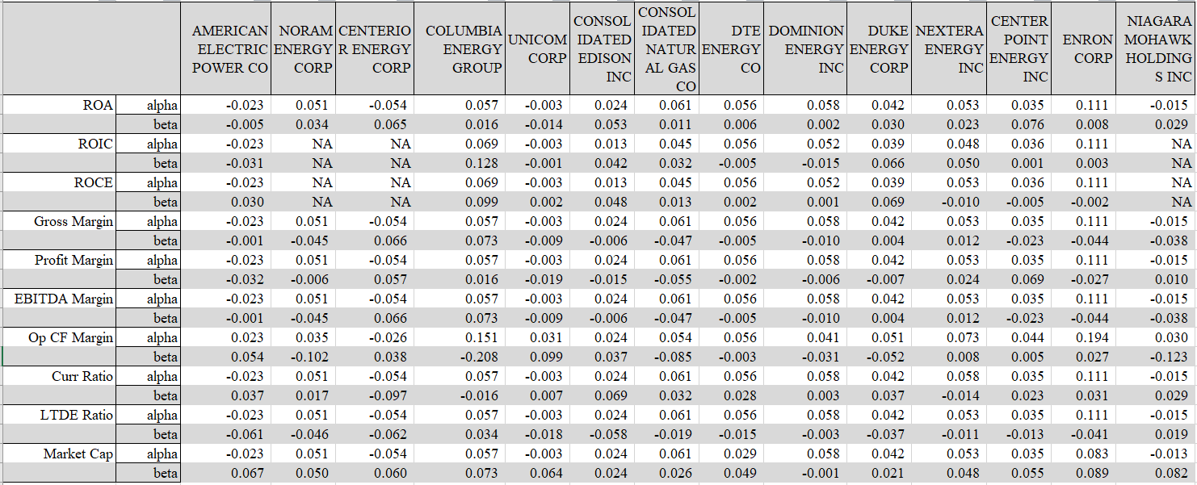
Individual Price Return vs Factors

Slide 38
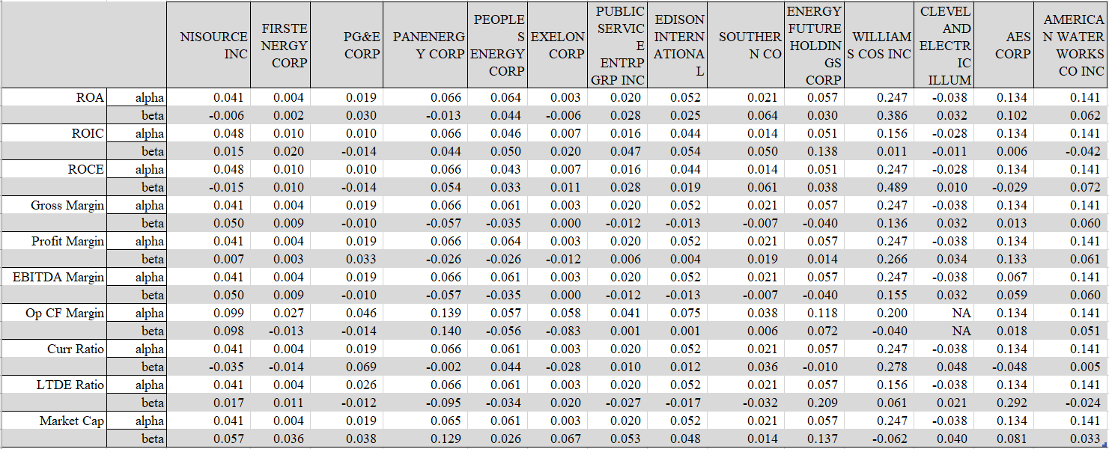
Individual Price Return vs Factors

Slide 39
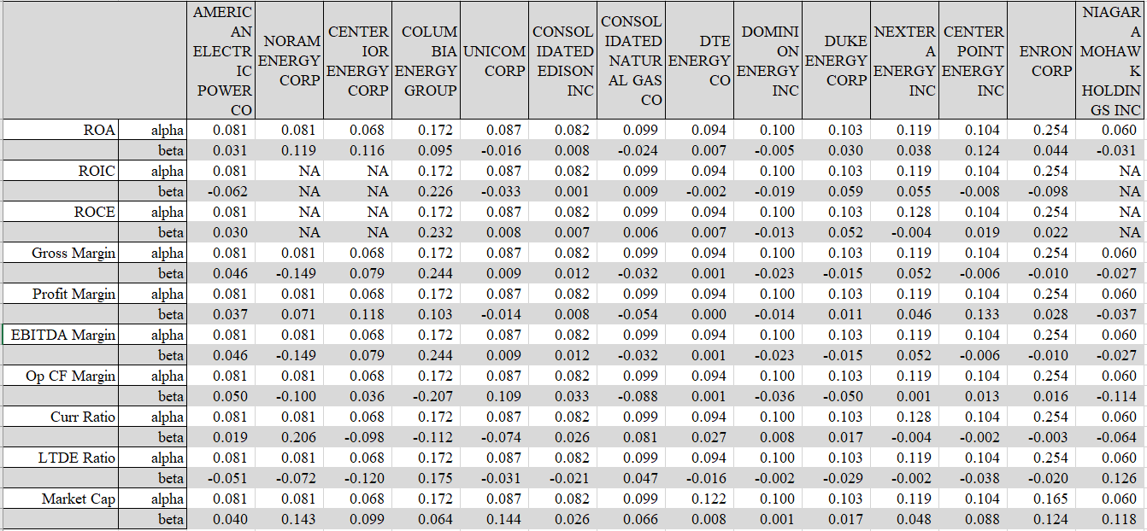
Individual Total Return vs Factors

Slide 40
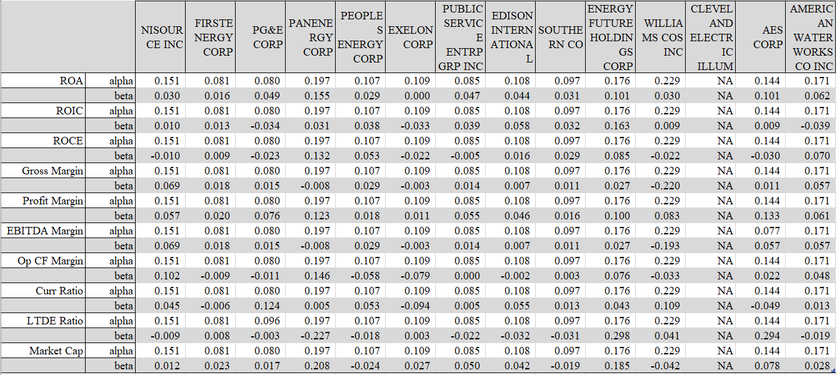
Individual Total Return vs Factors

Slide 41
Price Return vs Factors-R^2

Slide 42
Total Return vs Factors-R^2

Slide 43
Conclusion
7

